Slide 1


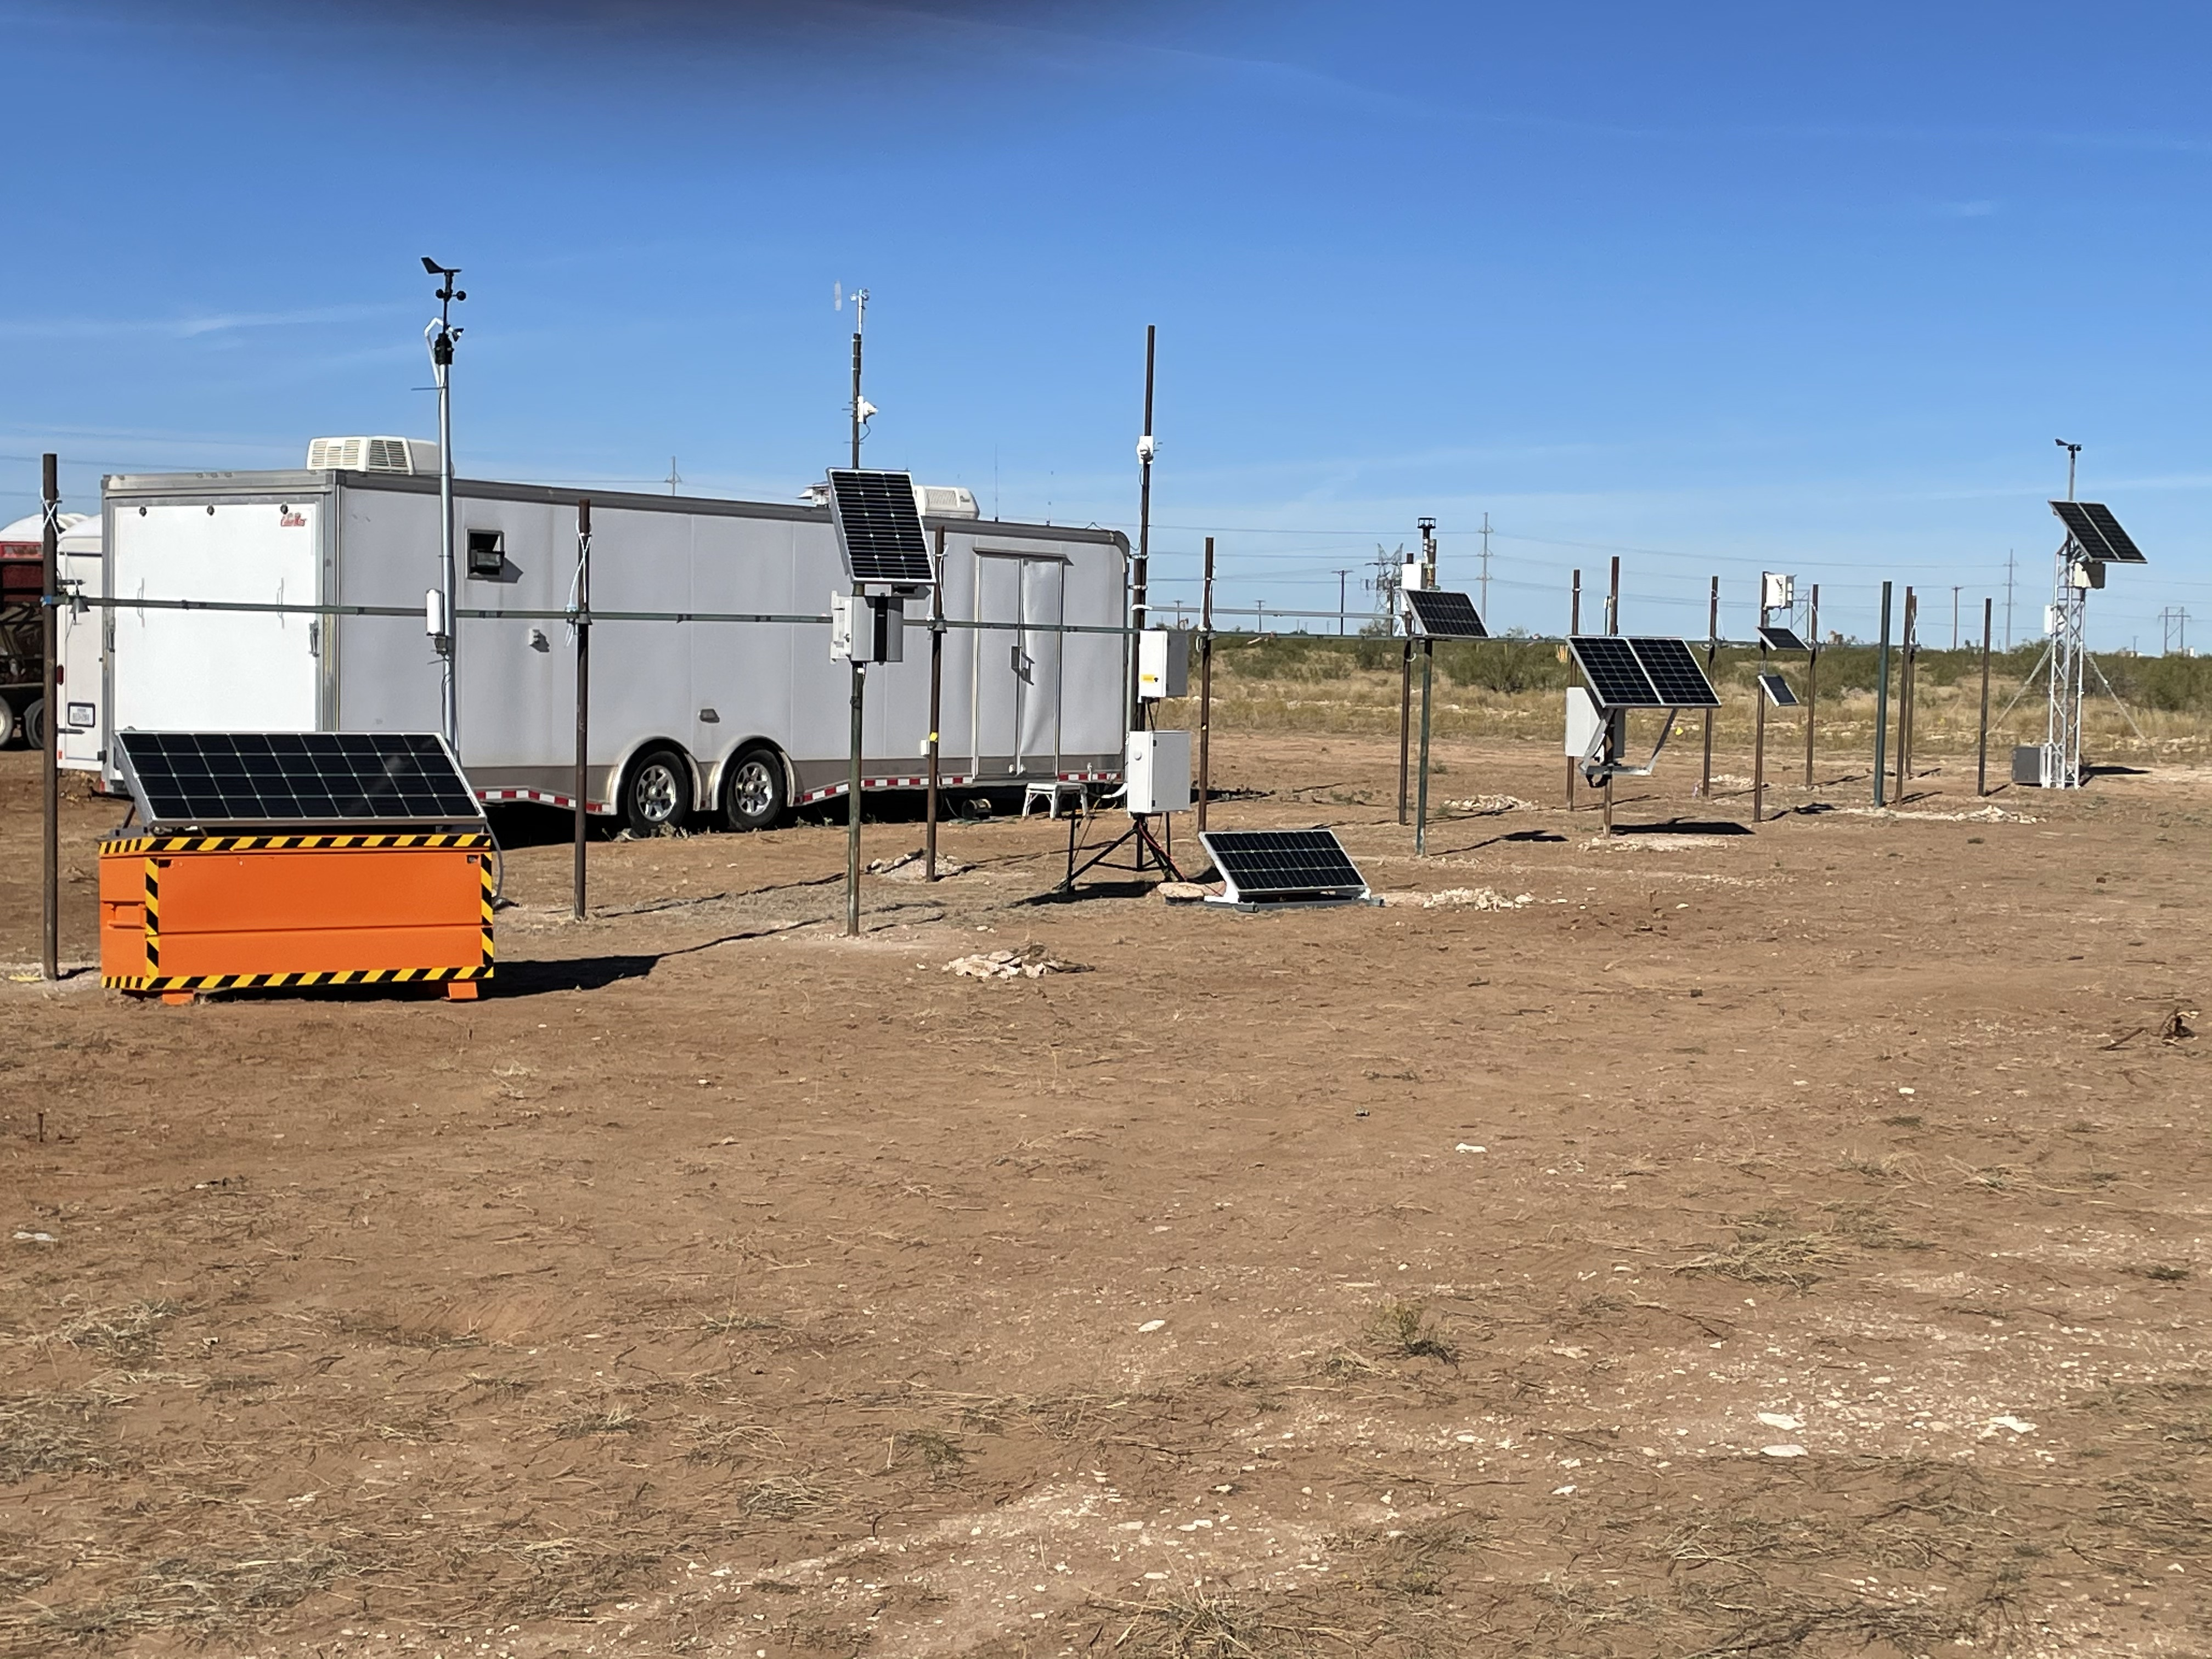
Methane sensor field inter-comparison
Vince Torres, David Sullivan, Jarett Spinhirne, Elyse Hebert, and David Allen
Center for Energy and Environmental Resources
University of Texas at Austin

Slide 2
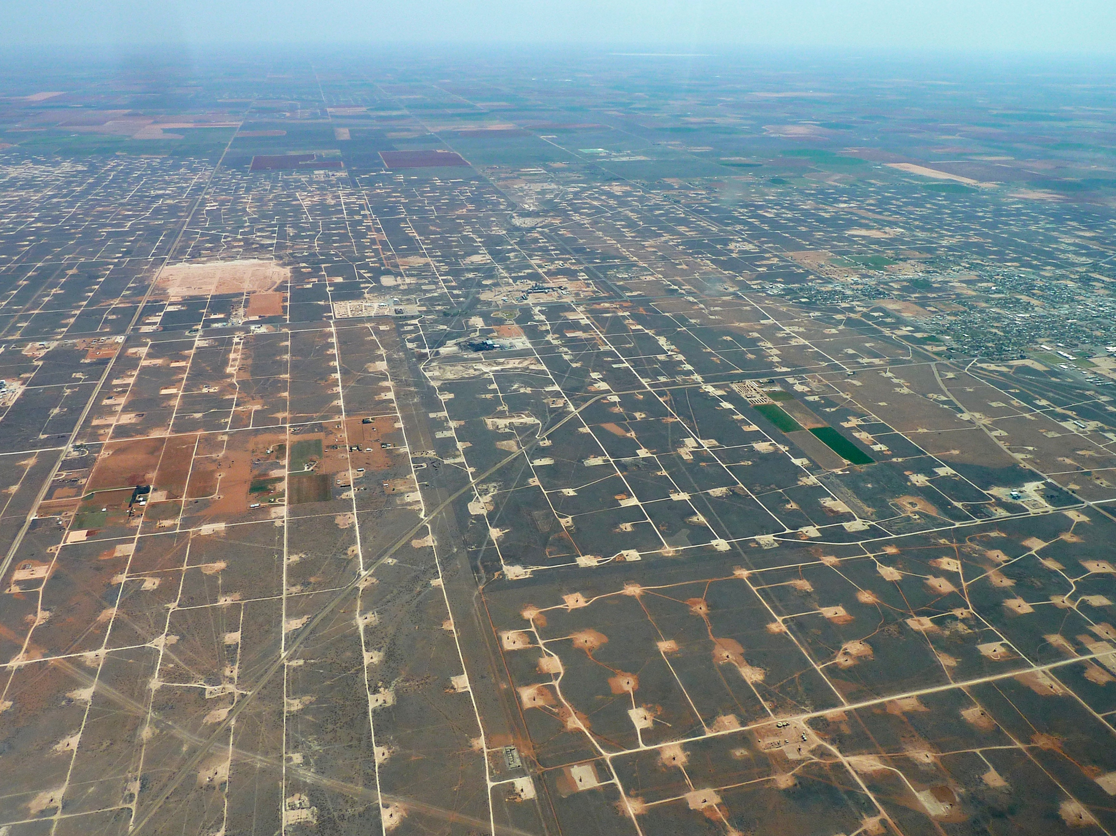
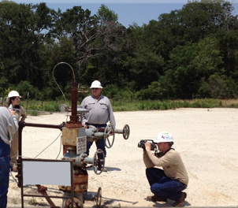
Sensor Inter-comparison is an element of Project Astra
(www.projectastra.energy)
Project Astra will demonstrate a novel approach to monitoring methane emissions from oil and gas production sites, using advanced sensing technologies and data analytics.
Project Astra will:
Transform methane emission detection from labor intensive surveys, inefficient at finding and slow to repair emissions, to sensor intensive continuous monitoring that will quickly alert operators to unintended emissions, so they can be addressed efficiently
At the same cost as current surveys, quickly find and repair emissions
Key step is determining capabilities of low-cost sensors

Slide 3
Key questions assessed during sensor inter-comparison
What precision and accuracy can be provided by low-cost methane sensors?
What is the data capture rate?
Does performance change over time?

Slide 4
Key questions assessed during sensor inter-comparison
What precision and accuracy can be provided by low cost methane sensors?
What is the data capture rate?
Does performance change over time?
Methods:
9 months of testing (October 2020 – June 2021)
7 sensors compared against multiple certified gas standards in single blind challenges
Sensors compared to a collocated state of the art TILDAS (1 ppb precision at 1 Hz)

Slide 5
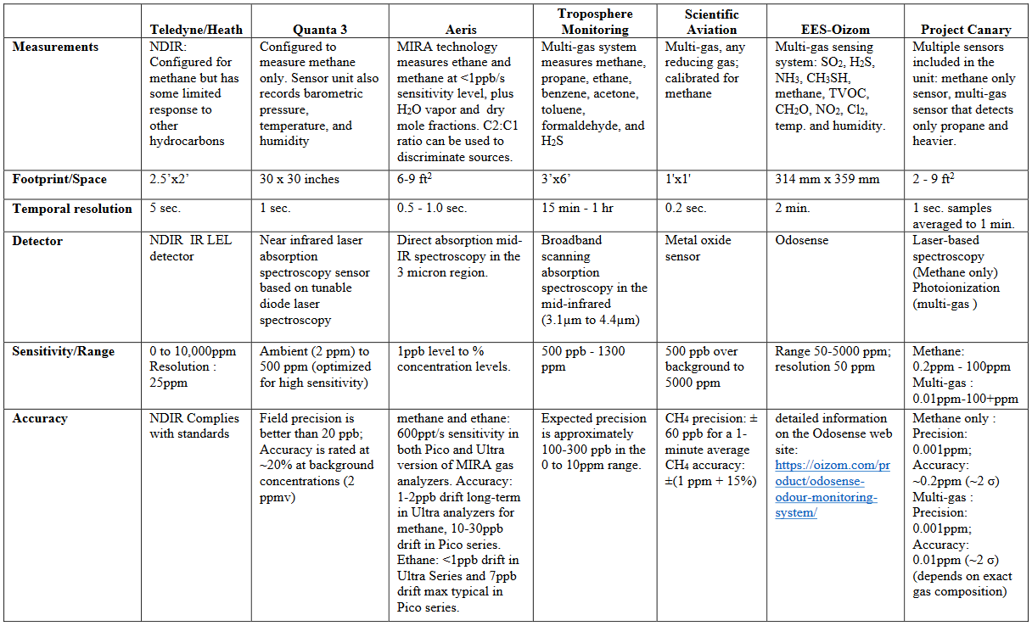

Slide 6

Methane Sensor Inter-comparison
Challenge gas comparisons
Comparison of individual sensors with TILDAS

Slide 7
First round of data release is for certified gas challenges
Key takeaways
  Multiple sensors appear to be viable candidates for Project Astra (Aeris, Canary, Quanta3, Scientific Aviation)
  Time response is different than detector response and is typically minutes for response to challenge gases

Slide 8
Gas Challenges
In each gas challenge, the gas is applied for ~4 minutes.
Four concentrations are used: 100 ppm, 10 ppm, 2.2 ppm, 2.1 ppm.
These concentrations are estimates from the lab that prepared the gas cylinders, and are approximations +/- 10%.

Slide 9
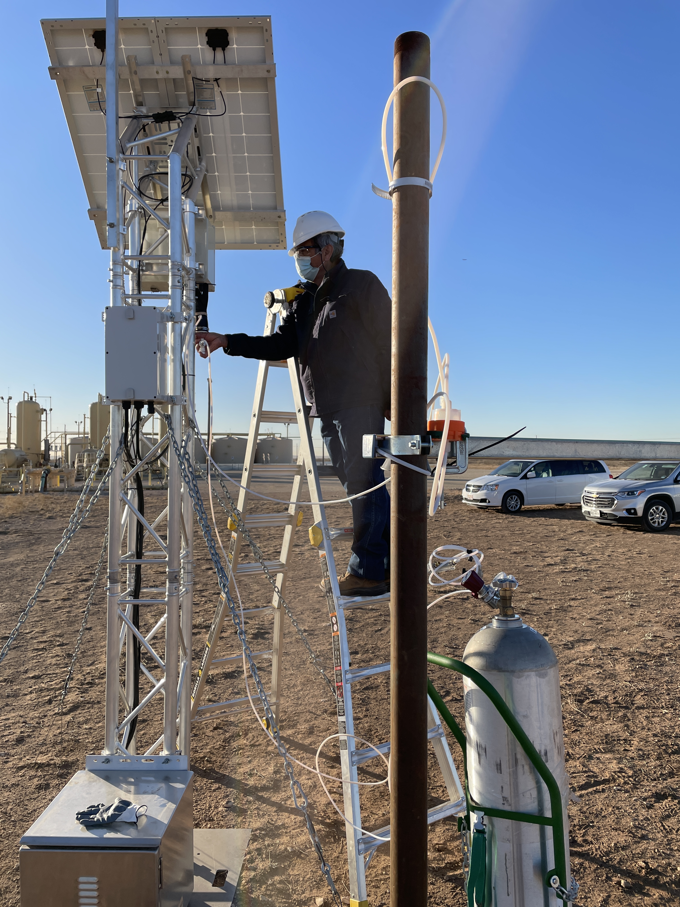
Certified gas challenge: gas delivery
Certified gas challenge delivery to sensors

Slide 10
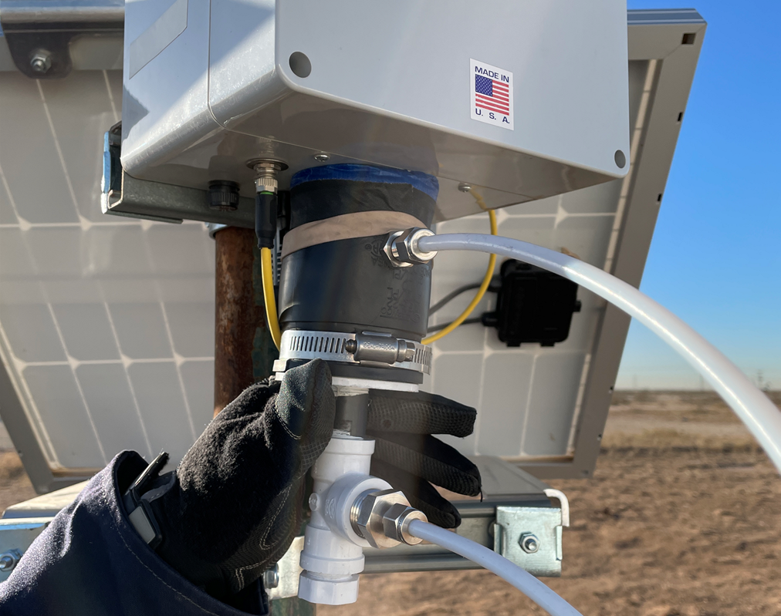
Certified gas challenge method
Deliver gas with known concentration (certified gas) to inlet of sensor
Simultaneously sample gas, delivered to sensor, with University of Texas operated state-of-the science, high precision QC-TILDAS instrument

Slide 11
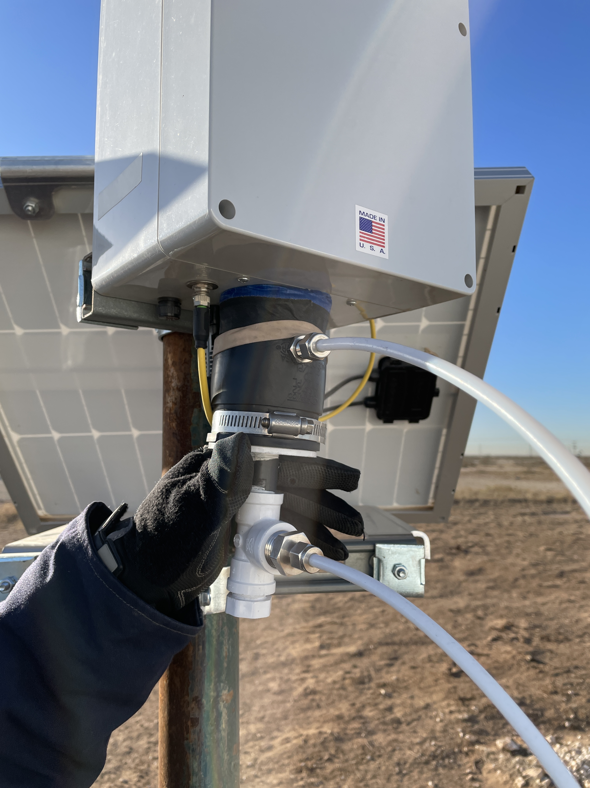
Standard challenge gas delivery device used on sensors
Soft closed cell foam gasket for seal
Sensor inlet gas concentration
sample line delivered to QC-TILDAS
Challenge gas supply line

Slide 12
Challenge Gas System up at Quanta3 Sensor
Challenge gas delivery device
Sensor inlet gas concentration
sample line delivered to QC-TILDAS
Challenge gas delivery line
Challenge gas cylinder

Slide 13
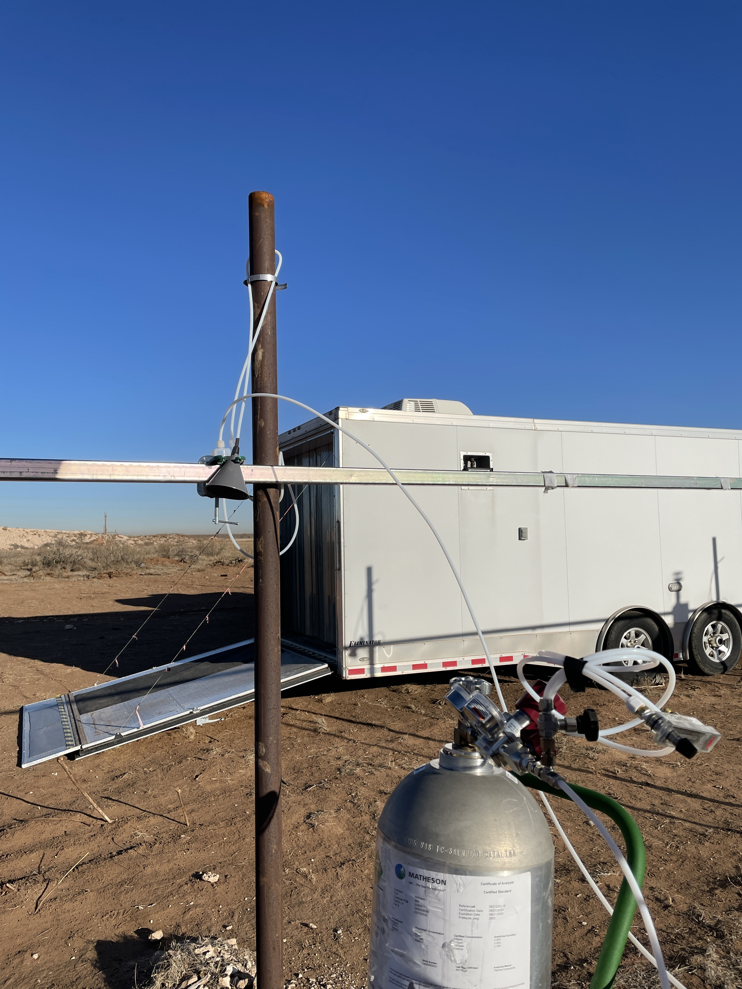
Delivery to TILDAS:
Standard ambient air sampling through inverted funnel, 9 positions
Filter
Ambient air sample line

Slide 14
Data release for certified gas challenges
Certified gas challenge delivery method
Typical data generated

Slide 15
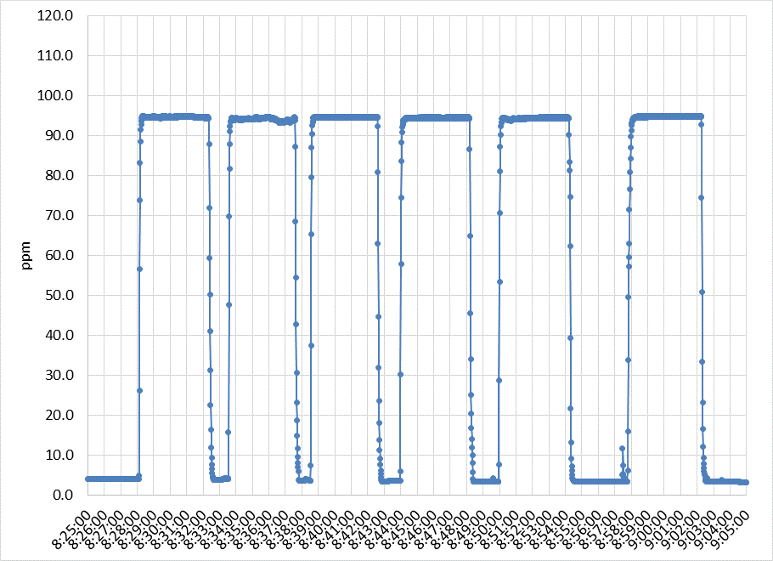
Typical data for University of Texas operated QC-TILDAS instrument
QC-TILDAS instrument begins sampling certified gas
End sampling of certified gas
Repeat analysis
QC-TILDAS instrument initially sampling ambient air
QC-TILDAS is the fastest response, most accurate and precise methane sensor available – in this case the gas was certified as 101 ppb methane, but the QCTILDAS value of 96 ppb is likely more accurate

Slide 16
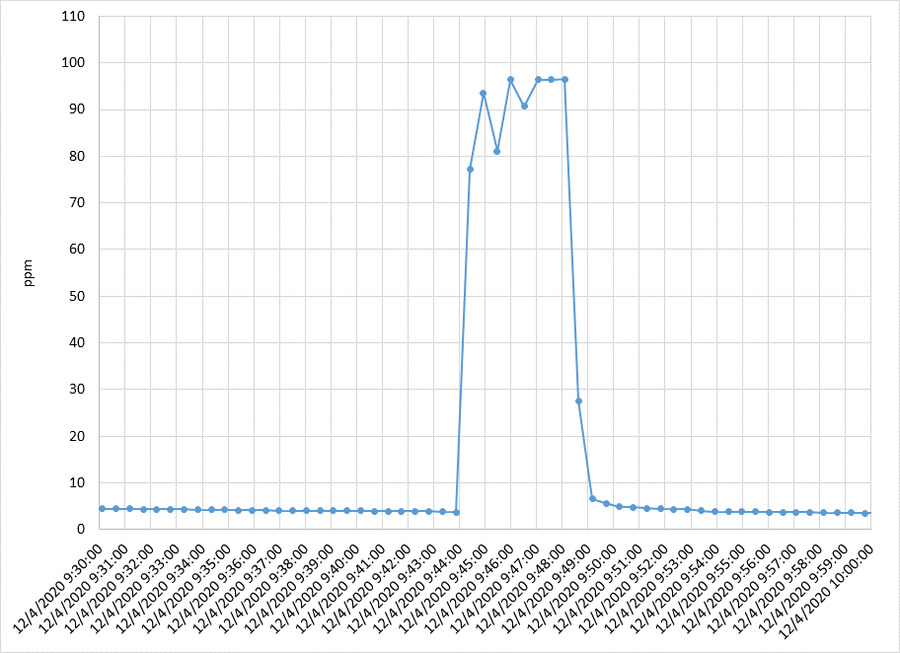
Comparison of a sensor that mirrors QC-TILDAS performance well (101 ppb challenge gas)
AERIS
QC-TILDAS

Slide 17
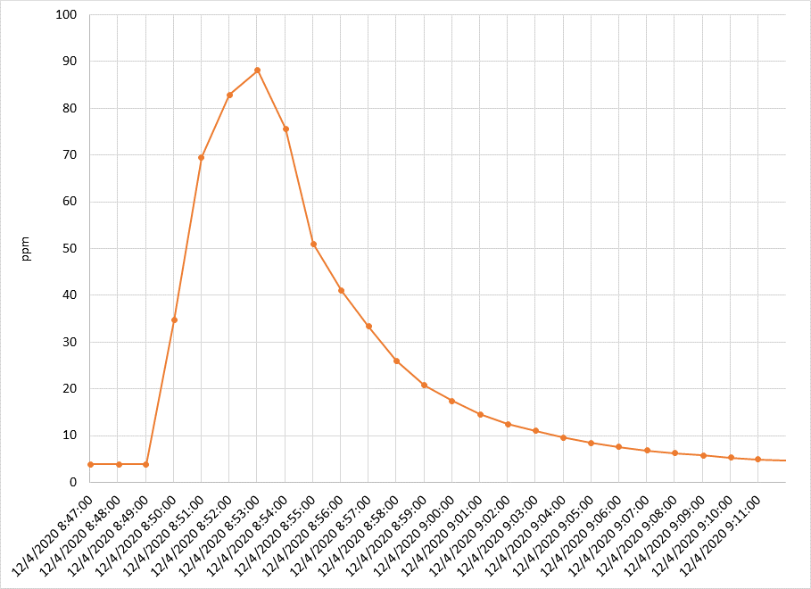
Comparison of a sensor with time lag
Canary sensor initial response ~5 minutes, with return to baseline <10 minutes
QC-TILDAS full response in ~15 seconds

Slide 19
Methane Sensor Inter-comparison
Challenge gas comparisons
Comparison of individual sensors with TILDAS

Slide 20
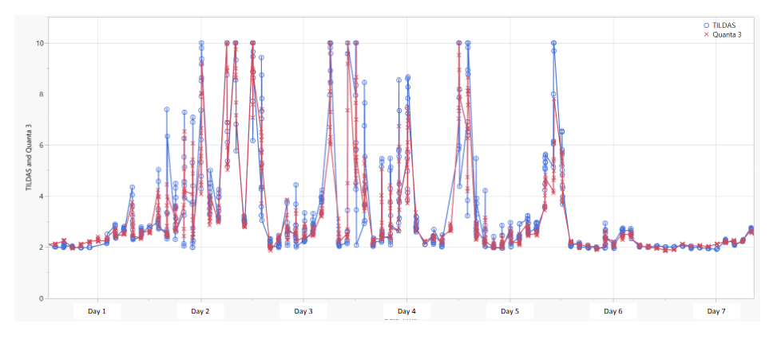
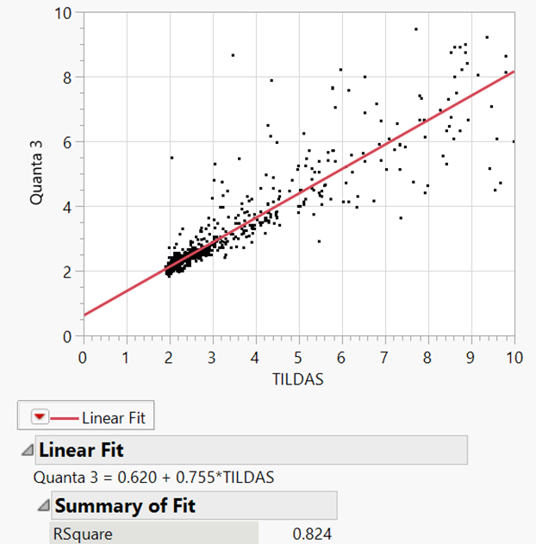
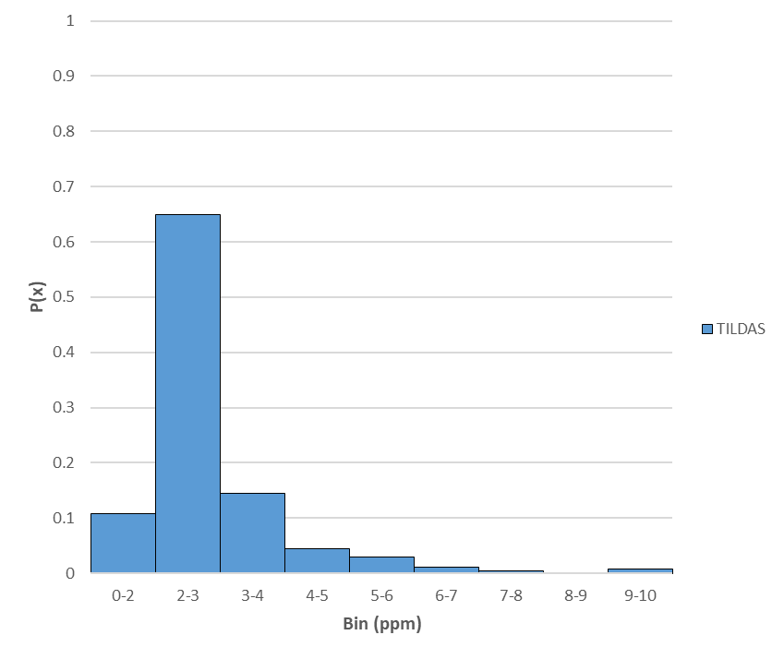
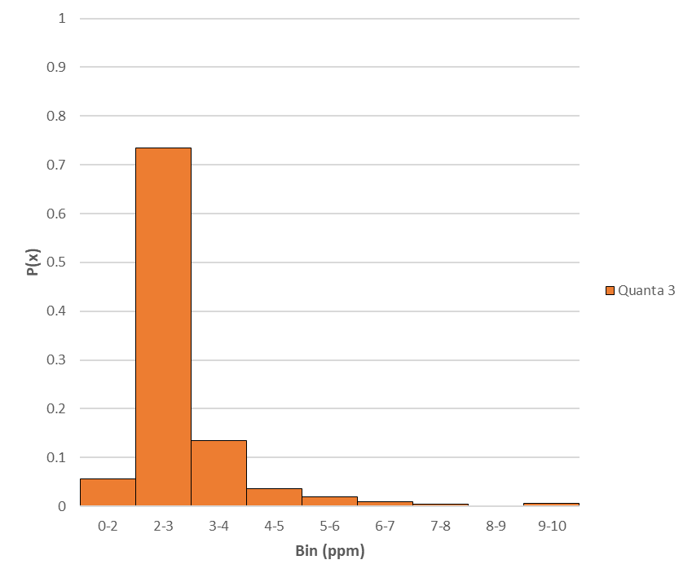
Methods of inter-comparison:
Three typical weeks of data (dates blinded); all comparisons based only on co-located sampling
Time series (1 minute, 1-hour and 4-hour averages)
Scatter plots
Data distributions for month-long time series

Slide 21
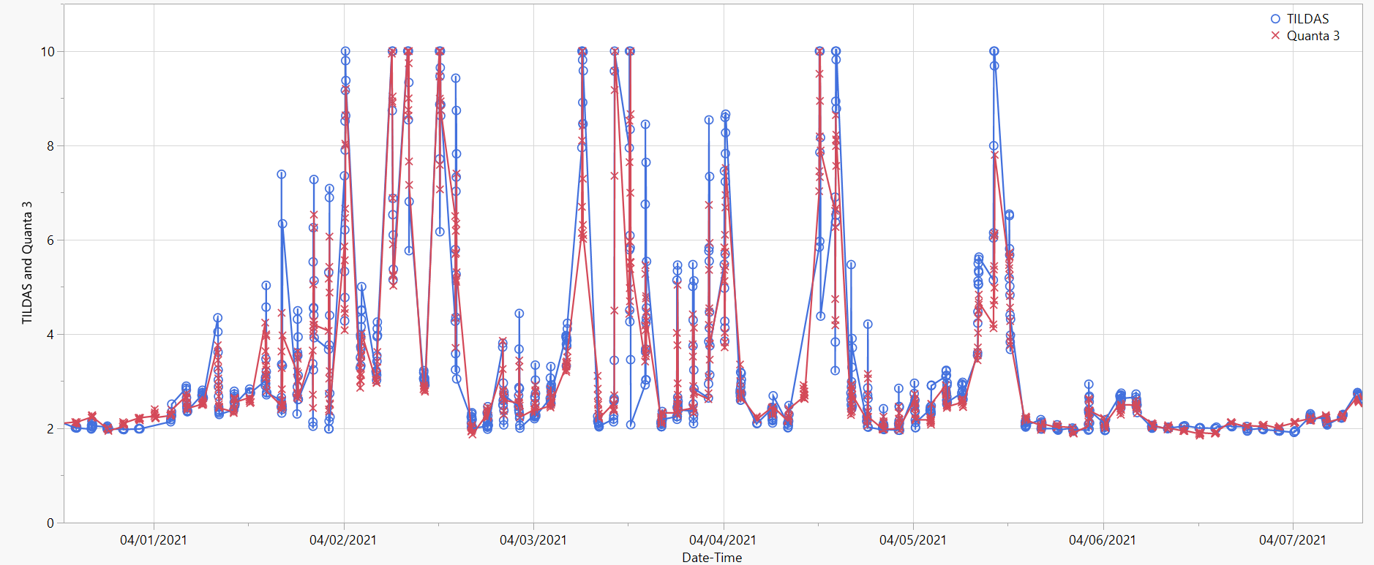
1-min TILDAS and Quanta 3 Time Series
High no. of elevated concentrations
Day 1
Day 2
Day 3
Day 4
Day 5
Day 6
Day 7

Slide 22
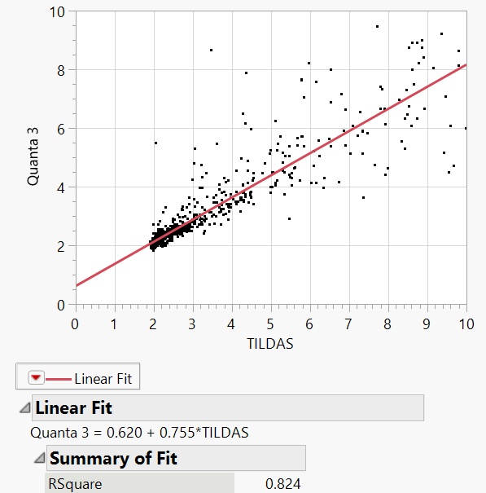
1-min TILDAS and Quanta 3 Scatter Plot
High no. elevated concentrations

Slide 23
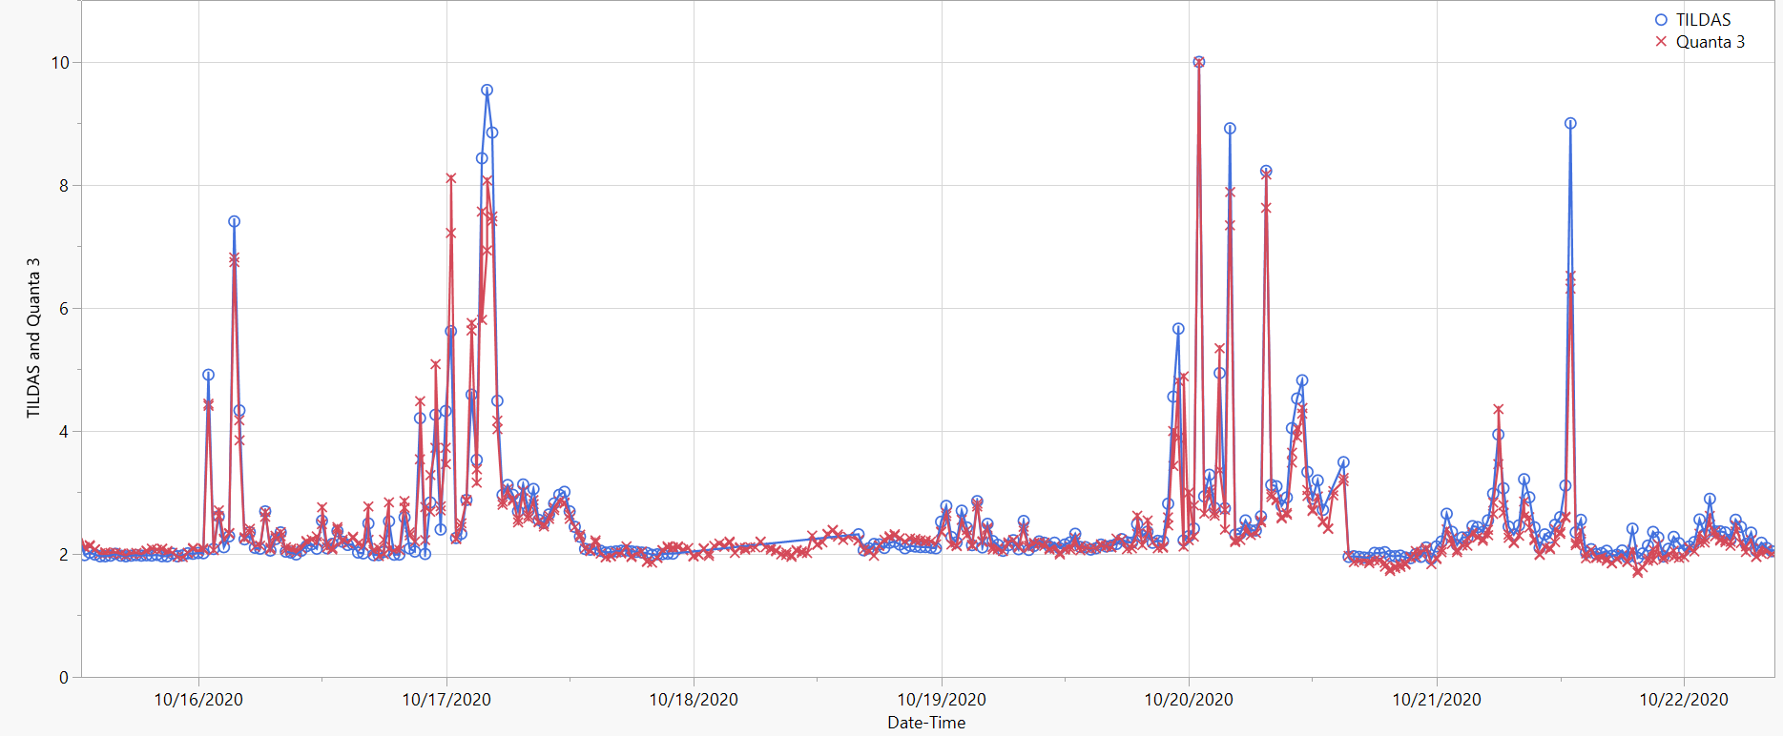
1-min TILDAS and Quanta 3 Time Series
Few no. of elevated concentrations
Day 1
Day 2
Day 3
Day 4
Day 5
Day 6
Day 7

Slide 24
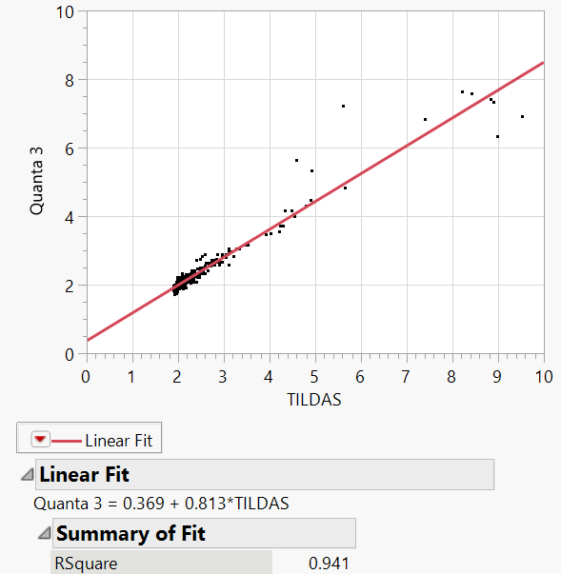
1-min TILDAS and Quanta 3 Scatter Plot
Few no. of elevated concentrations

Slide 25
Data distributions for TILDAS and Quanta 3
December 2020

Slide 26
Bias assessment
Record daily minimum value for each sensor as an indication of background concentration.
Differences may be attributed to systemic bias
TILDAS compared to Quanta 3, Aeris, Canary, and Scientific Aviation.

Slide 27
TILDAS
QUANTA3
AERIS
SCIENTIFIC AV.
CANARY

Slide 28
Improved performance of Scientific Aviation sensor when daily bias is subtracted
Week with high number of elevated concentrations
Week with low number of elevated concentrations

Slide 29
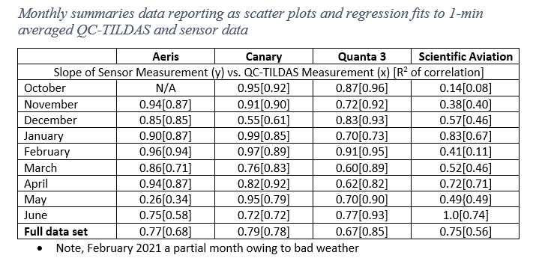
Summary statistics

Slide 30
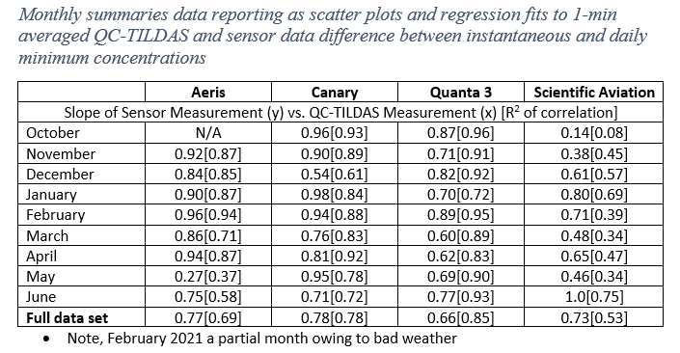
Summary statistics

Slide 31
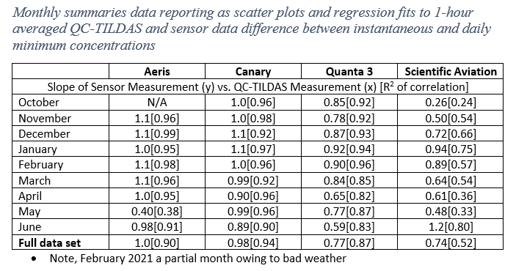
Summary statistics

Slide 32
Key questions assessed during sensor inter-comparison
What precision and accuracy can be provided by low cost methane sensors?
Multiple sensor systems have ~100 ppb field sensitivity at 1 Hz at a cost <$20,000; multiple sensor systems able to detect ~500 ppb-1 ppm changes in concentration at 1 minute resolution at a cost <$2000; sensor system costs include sensor, power, communication capabilities, and in most cases wind speed and wind direction data. Some sensors have additional detection capabilities.
What is the data capture rate?
Multiple high and medium precision sensors had high data capture rates (80-90%+)
Does performance change over time?
Multiple sensor systems challenged by dust
What emission rates can be detected by sensors operating at precisions of 100 ppb-1ppm?
Atmospheric dispersion modeling of the Astra pilot region indicates that emission rates of 5-10 kg/hr can be detected by a network of sensors with ~1 ppm sensitivity and a sensor density of <1 sensor system per site
Final report available at:
http://dept.ceer.utexas.edu/ceer/astra/

Slide 33



Sponsors of Methane Sensor Inter-Comparison
AT&T
Collaboratory to Advance Methane Science
Environmental Defense Fund
ExxonMobil
Pioneer Natural Resources
1.
2.
3.
More Information about Project Astra
Professor David Allen (allen@che.utexas.edu)
http://dept.ceer.utexas.edu/ceer/astra/
Methane Sensor Inter-comparison
Partners:
Chevron
Environmental Defense Fund ExxonMobil
Gas Technology Institute (GTI) Microsoft
Pioneer Natural Resources Schlumberger
University of Texas
Digital Methane Challenge
Project Astra Pilot
An in-field assessment and selection of sensors for the Project Astra pilot network
Using a digital twin of the pilot area, determine the optimized design of the sensor mesh network and the data analytics required to identify unintended emissions
A multi-month, operating pilot of the methane network in the Permian Basin
3Q 2020-3Q 2021 3Q 2020 – 4Q 2021 4Q 2021 - 2022

